Slide 1
Analysis of Global Greenhouse Gas Emission
Shweta Dutta
08.11.2019

Slide 2
Agenda
Climate Change – Greenhouse Gas Effect
Purpose of the Project
Analysis
Conclusion
Further Studies
Notes:
A glimpse through what is GHG and how the climate is getting affected
Purpose of the project
Analysis undertaken
Finally the conclusion from the analysis and further studies that can be done

Slide 3
Climate Change – Greenhouse effect
Changes are caused by extra heat in the climate system due to the addition of greenhouse gases to the atmosphere
Greenhouse gases - Water vapour, carbon dioxide, methane, nitrous oxide, ozone and some artificial chemicals such as chlorofluorocarbons (CFCs)
Greenhouse effect - Natural process that warms Earth’s surface
Enhanced greenhouse effect / Global Warming –
Process that raises the Earth’s temperature due to human factors
Impact -
Increased Air Temperatures
Ocean Warming and sea level rise
Extreme Weather events
Rainfall Patterns
Notes:
The climate we are living in is changing.
The additional greenhouse gases are caused by human activities such as the burning of fossil fuels (coal, oil, and natural gas), agriculture, and land clearing.
The major greenhouse gas is carbon dioxide (CO2) and nearly all CO2 comes from fossil fuels and land-use change. But methane (CH4) and nitrous oxide (N2O), which mostly come from agriculture and waste, are also significant GHGs and shouldn't be discounted.
Greenhouse effect is a natural process that warms the Earth’s surface: 33 degree C
Many of the impacts of climate change pose risks to human and natural systems.
Some major impacts are : …
Wet areas are likely to get wetter and dry regions are likely to be drier in response to climate change.

Slide 4
Purpose of the Project
Challenges - Rising levels of manmade greenhouse gases (GHGs) in the atmosphere and their resulting impact on climate
Purpose –
Identify the main source of greenhouse gas
Find how the emission values have changed over the years
Predict the emission values of the greenhouse gases when the emission values from sources are know
Forecast how much greenhouse gases will be emitted in future
Notes:
Both technological and environmental challenge
Should audit GHG fluxes at the factory, city, country and continental level
Monitoring of GHG
The possible questions now arise are:
How have global emissions of CO2 changed over time?
How have global emissions of CH4, N2O and F gases changed over time?
Which sector yield maximum greenhouse gas?
Which country/ continent is responsible for maximum emission of greenhouse gases?

Slide 5
Analysis
Data Description
Data Exploration
Basic Analysis
Principal Component Analysis
Linear Discriminant Analysis
Multivariate Analysis of Variance (MANOVA)
Multiple Regression
Advanced Analysis
Time Series Forecasting

Slide 6
Data Description
Source: Food and Agriculture Organization of the United Nations
Data on Emissions of greenhouse gases (GHG)
By gas, economic sector, country and year from 1990-2010.
Original Structure:
40,586 observations with 49 columns.
Area – 268 levels: 231 countries and 37 aggregate levels
Item (Source of Emission) – 14 levels
Element (Emission value/ share) – 14 levels
Total Emission of all gases, Emission from each gas
Share: Each gas in sector emissions, Sector in each emissions
Code – Area, Item, Element
Unit – Emission values in Gigagram, Share in %
Missing Values - Multiple
Notes:
Source- FAOSTAT
Record of 21 years
Countries: Spain, Kenya, India etc.
37 aggregate levels – World, Asia, Net Food Importing Developing Countries, Low Income Food Deficit Countries etc.
Source of Emission: Energy, Transport etc.
Area code, Item Code and Element Code columns contain the unique codes of the levels of Area, Item and Element, respectively.

Slide 7
Project Purpose - Reshaped Data
Number of observations: 147 obs. of Total Emission values
7 levels of Area
Asia, Africa, Europe, Oceania, North, Central and South America
10 levels of Items
8 levels - Energy, Transport, Residential/ Commercial/ Institutional, Industrial Processes, Agriculture, Land use sources, Other sources, Waste
2 aggregate levels - Energy Total, Land use Total
4 levels of Elements
Emissions from CO2, CH4, N2O, F gases
Missing Values - Absent
Notes:
For simplicity purposes and to have a broader picture, data was reshaped.
Continents and three parts of America are considered.
Few columns of ‘total sources’ are excluded.
Share of gases in the sector and share of sectors in each gases are excluded.
Only the 4 major gases emission values considered.

Slide 8
Data Exploration – Graphical Method
Fig.1
Fig.2
Fig.3
Conclusion:
Fig.1 ‘Energy’ and ‘Land’ are the main sources
Fig.2 CO2 is the most abundant GHG
Fig.3 Asia is the main source of CO2
Notes:
Considering most recently collected data for the year 2010, Sub divided bar diagram is used to find out which is the main source of GHG, and which GHG is most abundant.
Pie diagram is used to find out which level is the source of maximum emission of CO2.

Slide 9
Data Exploration – Numerical Method
Asia being the greatest continent - Maximum average GHG under all sectors
Energy – Sector with highest mean emission
CO2 – GHG that has highest average emission
Emission values of most Sources are correlated
Transport, Land has very less correlation values with some sectors
Notes:
Energy – 25,42,704 ~ 25 lakh gigagram
Sources – Energy, Transport etc.

Slide 10
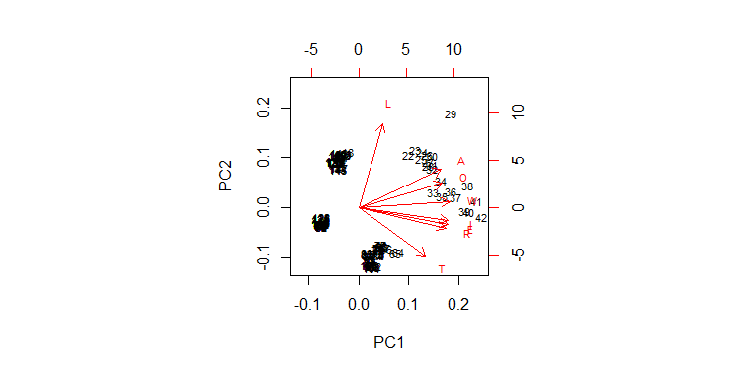
Principal Component Analysis
Uses orthogonal transformation to convert correlated variables into a set of linearly uncorrelated variables
Principal Components - new set of uncorrelated variables
Results:
Most of the variation can be captured using the first 2 principal components
First two principal components explain 93.15% of the total sample variance
Total variance explained by the components: 8
Biplot of 1st and 2nd PCs:
 | PC1 | PC2 | PC3 | PC4 | PC5 | PC6 | PC7 | PC8
Standard Deviation | 2.4474 | 1.2094 | 0.5661 | 0.3482 | 0.2684 | 0.1503 | 0.8662 | 0.0626
Proportion of variance | 0.7487 | 0.1828 | 0.0400 | 0.0151 | 0.0090 | 0.0028 | 0.00094 | 0.00049
Cumulative Proportion | 0.7487 | 0.9315 | 0.9715 | 0.9867 | 0.9957 | 0.9985 | 0.9995 | 1
Notes:
Analysis for Data reduction
Finds the best low dimensional representation of variation in the multivariate data set.
Suppose there are p components that produces the total system variability, often it is observed that much of this variability can be accounted for by a small number of principal components, say k<p. In such case, the k principal components can replace the initial p variables and the original data set of n observations on p variables reduces to a data set consisting of n observations on k principal components.
In the dataset, we have emission values from 8 different resources obtained from 7 different levels.
Carried out PCA after scaling the data.
From the table above, it is observed that the first principal component explains 74.87% of the total sample variance. The first two principal components collectively explain 93.15% of the total sample variance. The data from 147 observations on 8 variables reduced to 147 observations on 2 principal components.
Also, the principal components are predicted after that and the rotation matrix is also obtained.
Biplot displays the data points along the PCs and indicates the contributions of each of the variables to these PCs.

Slide 11
Linear Discriminant Analysis
Finds the linear combinations of the original variables giving the best possible separation between the groups in the data set
Results: At most 6 useful discriminant functions to separate the emissions by levels
Proportion of Trace - Proportion of between-class variance explained by successive discriminant functions
Linear Discriminant 1 explains 57.66% of the total variance
 | LD1 | LD2 | LD3 | LD4 | LD5 | LD6
Proportion of Trace | 0.5766 | 0.3640 | 0.046 | 0.0114 | 0.0007 | 0.0004
Notes:
In the previous method, principal components analysis pays no attention to groupings in the data and finds axes that maximize total variation. But, LDA is used for modeling differences in groups i.e. separating two or more classes.
Linear discriminant function analysis is used to find axes (linear combinations of variables) that best separate predefined groups. The axes maximize variation between groups relative to variation within groups.
Also known as “canonical discriminant analysis”, or “discriminant analysis”.
Maximum number of useful discriminant functions that can separate the emission values by levels is the minimum (G-1, p) = minimum (6, 8) = 6.
Can predict the value of all 6 discriminant functions and matrix of loadings of discriminant functions is obtained.
Stacked Histogram displays the results of LDA where a stacked histogram of the values of the discriminant function for the samples from different groups.

Slide 12
MANOVA
Tests for the difference in two or more vectors of means
Extension of ANOVA, takes a combination of dependent variables
Assumptions:
Independent Observations
Independent Variables – Categorical, Dependent Variables – Continuous
Absence of Multicollinearity
Multivariate Normality
Homogeneity of Variance
Results:
Mean values of Areas of Source and GHG variables are significantly different
MANOVA | P value | Accept/Reject
Emission from Sources | <0.05 | Reject
Emission of GHG | <0.05 | Reject
Notes:
ANOVA or Analysis of Variance is a group of statistical models to test for significant difference between means - tests whether the means of various groups are equal or not.
effect of one or more independent variables on two or more dependent variables
Assumptions:
Independent Random Sampling - MANOVA assumes that the observations are independent of one another
dependent variables cannot be too correlated to each other
Variance between groups is equal
Carried out MANOVA to test difference of means of the various groups of Area of
4 variables “Emission of GHG”
8 variables “Emission from Sources”

Slide 13
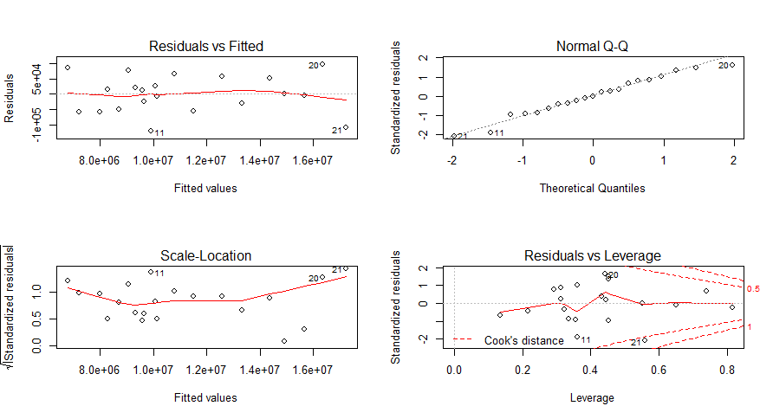
Multiple Regression
To predict the value of a variable based on the value of two or more other variables
Variable to be predicted – Dependent variable
Results:
For area “Asia”
Regression type | Adjusted R square
Regressing “Emission of CO2” on other variables. | 99.94%
Regressing “Emission of N2O” on other variables. | 99.75%
Regressing “Emission of CH4” on other variables. | 99.65%
Regressing “Emission of F gases” on other variables. | 99.19%
Plots obtained from “Regressing “Emission of CO2” on other variables.”
Notes:
Multiple regression is an extension of simple linear regression.
Multiple linear regression attempts to model the relationship between two or more explanatory variables and a response variable by fitting a linear equation to observed data.
In the given data set, the variables “Emission of CO2, CH4, N2O, F gases” are dependent in nature with that of the variables of “Emission from sources”. Since there share of values are already included in the other variables of “Emission from sources”.
Thus, we can regress the dependent variables on the independent variables, keeping an area fixed, and predict the future values of gases when the emissions from sources are already know to us.
The first plot (corner left) gives the plot of “Residual v/s Fitted values”
The second plot (corner right) gives the Normality Q-Q plot. Most of the values fall on the straight line and thus it can be commented that the values follow Normality assumption.
The observations with the index 11, 20, 21 i.e., on the years 2001, 2009, 2010 are considered as outliers.
Note: Similarly, for other areas also, similar results can be obtained.

Slide 14
Time Series Forecasting
Forecasting - Method for predicting probable amount in the future, based on the analysis of past amount under the present condition
Autocorrelation measures correlation between observations as a function of the time lag between them
Results:
All the variables have significant auto correlation
Data set can be considered as a Time Series Data of 21 years
Auto Regressive Integrated Moving Average model is fitted to the data
Based on ARIMA model, forecast is generated for all the variables for next 10 years
Notes:
When the past data is used to predict the future amounts, then this method is referred as time series method.
Examples of method of Time Series Forecasting include Moving Average, Exponential Smoothing, and ARMA/ARIMA etc.
Values of autocorrelation imply the values of emission on a year significantly depends on that of the past years.

Slide 15
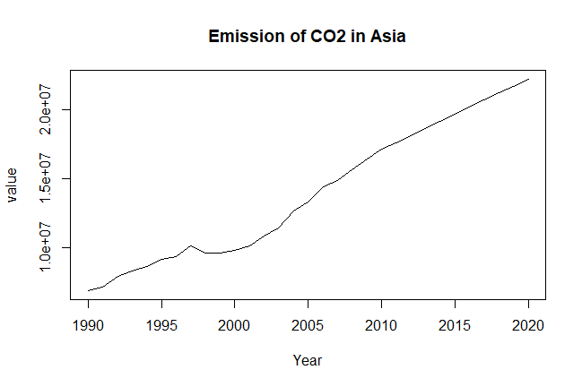
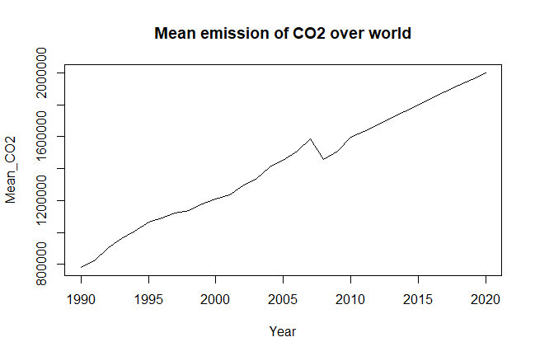
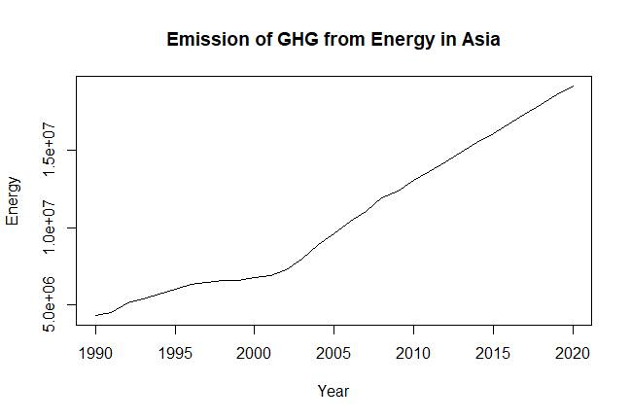
Conclusion
In Asia, extreme increase in
Emission of CO2 gas
Emission of GHG from ‘energy’ sector
Increase in Emission of CO2 in the world
World
Asia
Notes:
From the forecast values obtained, a graph can be plotted between years and the emission values to notice where the future is heading towards.
From the graph above, it can be seen that there has been extreme increase in emission of CO2 gas in Asia, and the forecast also shows that the amount will keep on increasing in future.
Thus, it is high time when each one of us should be aware of the current and upcoming environment situation and start taking steps to save the planet earth and make the environment a better place to live

Slide 16
Further Studies
While applying MANOVA, the validity of the assumptions to be checked
To have a more generalized method of forecasting for better forecasts
Carry out similar analysis to have a detailed picture considering each countries
Notes:
The method used here to generate forecast values is “Auto Regressive Integrated Moving Average method (ARIMA)”. The other methods “Holt Winter’s Exponential Smoothing” or “Moving Average” are not considered. Thus, it may be so that some other method gives better forecast values.
The forecast values generated by using the “auto.arima” function in R. This function automatically chooses the best ‘p’, d’, ‘q’ values. Also, during forecast the whole of the dataset is considered and the usual procedure of dividing the data into “training” and “testing” part and then applying the method is not considered. Thus, this technique can be made more detailed, so that better forecasts are generated.
So that each country can take necessary precautionary steps, beforehand.

Slide 17
THANK YOU!

